Slide 1
Micro CSI: A Microbial Citizen Science Initiative in Urban Watersheds
Marirosa Molina¹, Mike Cyterski¹, David Spidle¹, Blake Snyder², and Ourania Georgacopoulos³
¹US Environmental Protection Agency, Office of Research and Development, Athens, GA,
²Oak Ridge Institute for Science and Education, Oak Ridge, Tennessee
³Student Services Contractor for the USEPA, Athens, GA
The views expressed in this presentation are those of the authors and do not necessarily reflect the views or policies of the U.S. Environmental Protection Agency

Slide 2
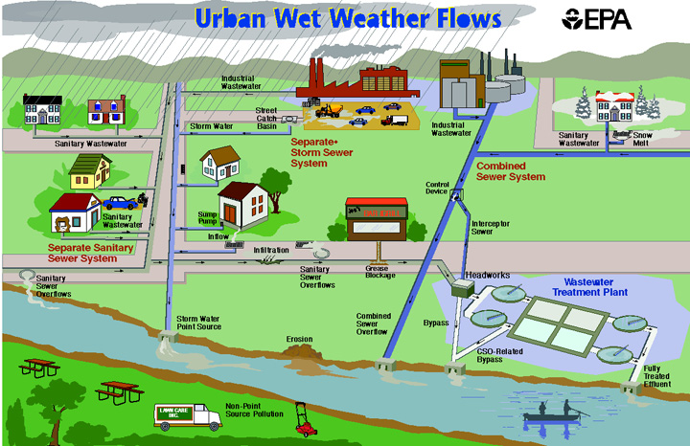
Citizen Science Approach
Oxford dictionary definition in 2014:
“Scientific work undertaken by members of the general public, often in collaboration with or under the direction of professional scientists and scientific institutions”
The aim of this effort is to engage volunteers or citizen scientists to collect water samples and perform basic water quality and microbial analysis from a variety of urban stream locations to develop statistical models able to predict impairment due to fecal bacterial.

Slide 3
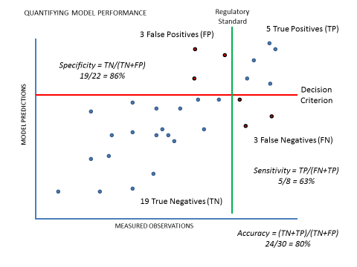
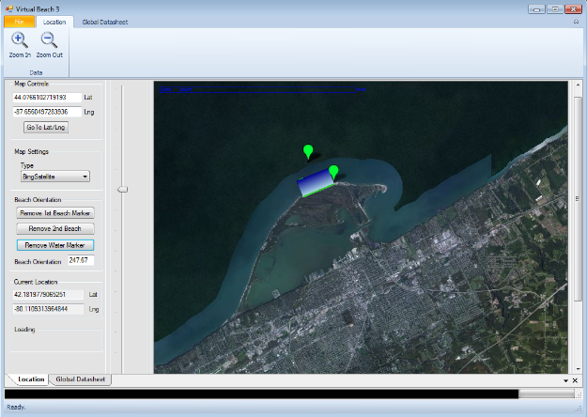
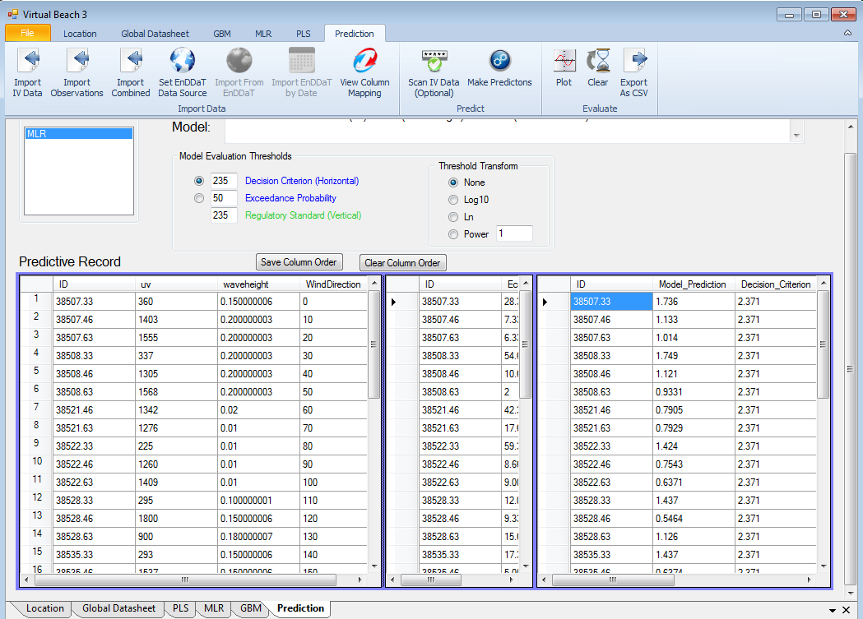
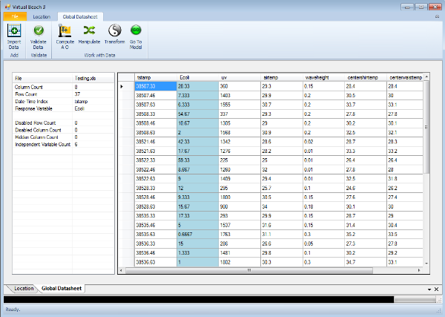
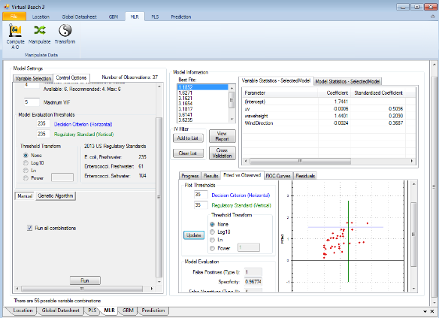
Virtual Beach
A decision-support tool that facilitates the process of building and implementing a statistical model for predicting water quality
Prediction
Mapping Interface
Data Processing
Modeling

Slide 4
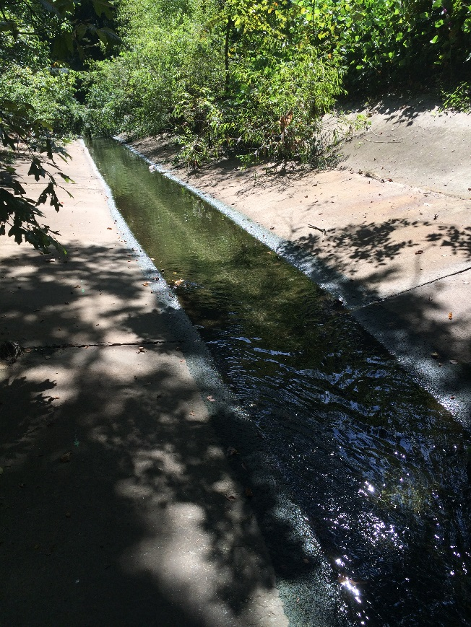
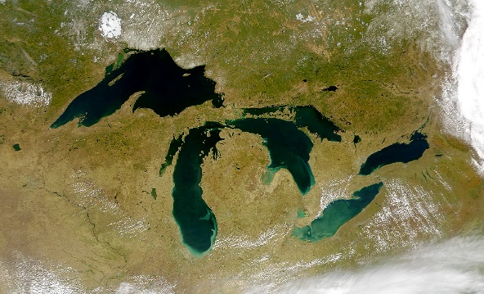
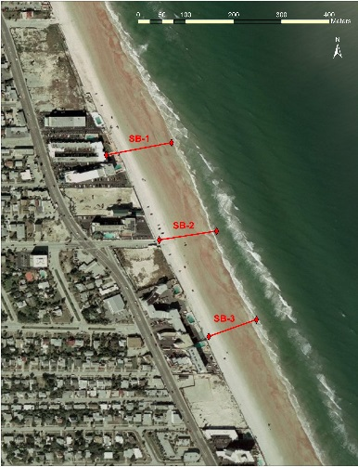

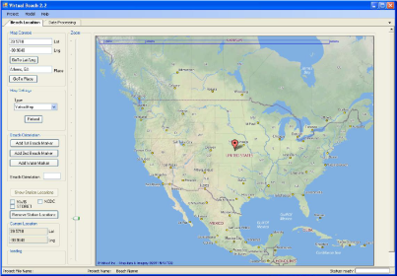
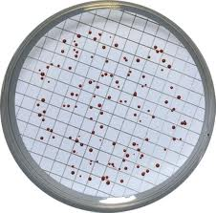
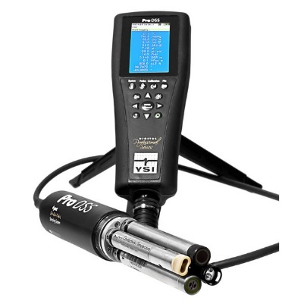
Rapid Assessment Approach to Determine FIB Concentrations in Urban Streams
Obtain concurrent fecal indicator bacteria (FIB) concentrations and independent variables at sampling locations
Develop a robust set of information suitable to test and implement the use of VB for rapid assessments in urban locations.
Identify correlations between environmental parameters and FIB
Integrate information with microbial source tracking data to identify urban hotspots
Not applied in rivers and streams
Notes:
The general approach for the project is to ….

Slide 5
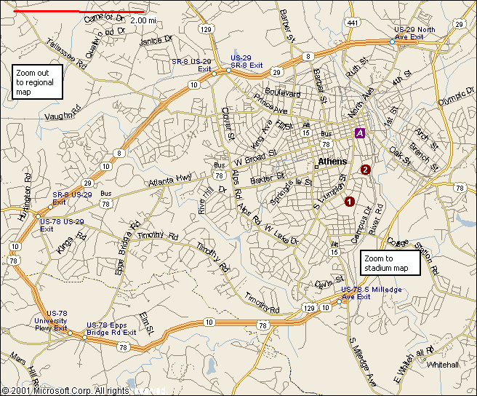
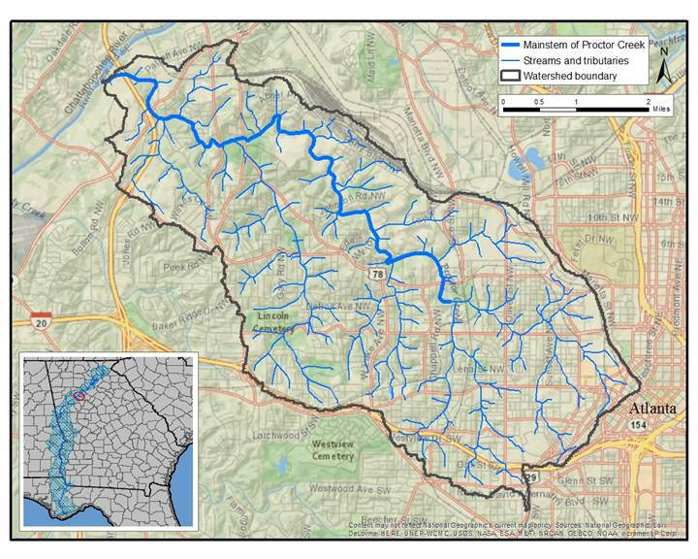
Study Locations
Upper Oconee River Watershed, Athens, GA
Proctor Creek watershed, Atlanta, GA
Lillian Cooper Park
Kerry Circle
Northwest
James Jackson
Hortense
Hollowell
North Outfall CSO
Spring St.
Grove Park
Lindsay St.
North Ave.
Greensferry
Burbank

Slide 6
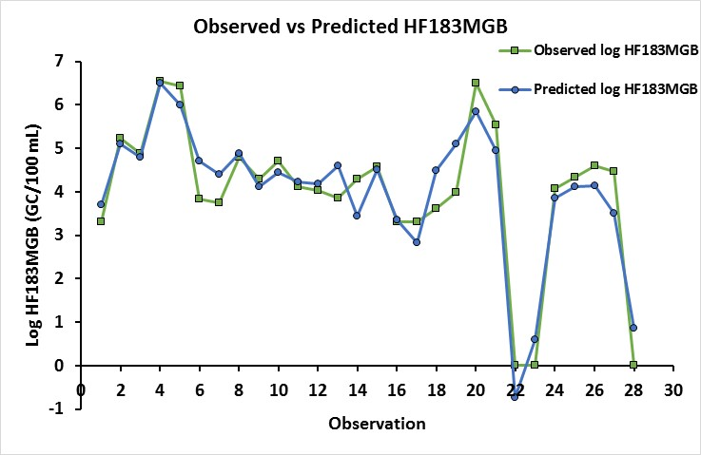
Preliminary Results
Turbidity and log qPCR E. coli were able to predict (R² = 0.87) the presence of the human associated marker.

Slide 7
Collaborators and Stakeholders
UOWN
River Basin Center at UGA
Chattahoochee River Keeper
Athens-Clarke County Unified Government
City of Atlanta
USEPA Region 4
Provide EPA Offices and Regions, State and County Governments with guidance on how to implement the use of statistical modeling approaches to determine impairment due to FIB contamination in urban streams.

